Slide 1
Number Theoretic Algorithms
Introduction, Strassen’s Multiplication

Slide 2
Importance of Number Theory
Before the dawn of computers, many viewed number theory as last bastion of “pure math” which could not be useful and must be enjoyed only for its aesthetic beauty.
No longer the case. Number theory is crucial for encryption algorithms.

Slide 3
Divisors
DEF: Let a, b and c be integers such that
a = b ·c .
Then b and c are said to divide (or are factors) of a, while a is said to be a multiple of b (as well as of c). The pipe symbol “|” denotes “divides” so the situation is summarized by:
b | a ∧ c | a .

Slide 4
Divisors. Examples
Q: Which of the following is true?
77 | 7
7 | 77
24 | 24
0 | 24
24 | 0

Slide 5
If a>0 & d|a then |d|<=|a|
a is a multiple of d
d|a & d>=0, d is a divisor of a, d should be atleast 1, but not greater than a
Trivial divisors of a is 1 & a
Non trivial divisors of a is/are factors of a

Slide 6
Prime Numbers
DEF: A number n ≥ 2 prime if it is only divisible by 1 and itself. A number n ≥ 2 which isn’t prime is called composite.
Q: Which of the following are prime?
0,1,2,3,4,5,6,7,8,9,10

Slide 7
Prime Numbers
A:
0, and 1 not prime since not positive and greater or equal to 2
2 is prime as 1 and 2 are only factors
3 is prime as 1 and 3 are only factors.
4,6,8,10 not prime as non-trivially divisible by 2.
5, 7 prime.
9 = 3 · 3 not prime.
Last example shows that not all odd numbers are prime.

Slide 8
Fundamental Theorem of Arithmetic
THEORM: Any number n ≥ 2 is expressible as as a unique product of 1 or more prime numbers.
Note: prime numbers are considered to be “products” of 1 prime.
Q: Express each of the following number as a product of primes: 22, 100, 12, 17

Slide 9
Division
Remember long division?
117 = 31·3 + 24
a = dq + r
q the quotient
d the divisor
a the dividend
r the remainder

Slide 10
Division
THM: Let a be an integer, and d be a positive integer. There are unique integers q, r with r ∈ {0,1,2,…,d-1} satisfying
a = dq + r
The proof is a simple application of long-division. The theorem is called the division algorithm
a/d ,iff a mod d=0

Slide 11
Greatest Common Divisor Relatively Prime
DEF: Let a,b be integers, not both zero. The greatest common divisor of a and b (or gcd(a,b) ) is the biggest number d which divides both a and b.
DEF: a and b are said to be relatively prime if gcd(a,b) = 1, so no prime common divisors.

Slide 12
Greatest Common Divisor Relatively Prime
Q: Find the following gcd’s:
gcd(11,77)
gcd(33,77)
gcd(24,36)
gcd(24,25)

Slide 13
Greatest Common Divisor Relatively Prime
A:
gcd(11,77) = 11
gcd(33,77) = 11
gcd(24,36) = 12
gcd(24,25) = 1. Therefore 24 and 25 are relatively prime.
NOTE: A prime number are relatively prime to all other numbers which it doesn’t divide.

Slide 14
Greatest Common Divisor Relatively Prime
EG: Find gcd(98,420).
Find prime decomposition of each number and find all the common factors:
98 = 2·49 = 2·7·7
420 = 2·210 = 2·2·105 = 2·2·3·35= 2·2·3·5·7
Underline common factors: 2·7·7, 2·2·3·5·7
Therefore, gcd(98,420) = 14

Slide 15
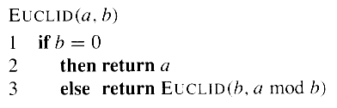
Euclid’s Algorithm for calculating gcd

Slide 16
Euclidean Algorithm. Example
gcd(33,77):
Step | r = x mod y | x | y
0 | - | 33 | 77

Slide 17
Euclidean Algorithm. Example
gcd(33,77):
Step | r = x mod y | x | y
0 | - | 33 | 77
1 | 33 mod 77 = 33 | 77 | 33

Slide 18
Euclidean Algorithm. Example
gcd(33,77):
Step | r = x mod y | x | y
0 | - | 33 | 77
1 | 33 mod 77 = 33 | 77 | 33
2 | 77 mod 33 = 11 | 33 | 11

Slide 19
Euclidean Algorithm. Example
gcd(33,77):
Step | r = x mod y | x | y
0 | - | 33 | 77
1 | 33 mod 77 = 33 | 77 | 33
2 | 77 mod 33 = 11 | 33 | 11
3 | 33 mod 11 = 0 | 11 | 0

Slide 20
Euclidean Algorithm. Example
gcd(244,117):
Step | r = x mod y | x | y
0 | - | 244 | 117

Slide 21
Euclidean Algorithm. Example
gcd(244,117):
Step | r = x mod y | x | y
0 | - | 244 | 117
1 | 244 mod 117 = 10 | 117 | 10

Slide 22
Euclidean Algorithm. Example
gcd(244,117):
Step | r = x mod y | x | y
0 | - | 244 | 117
1 | 244 mod 117 = 10 | 117 | 10
2 | 117 mod 10 = 7 | 10 | 7

Slide 23
Euclidean Algorithm. Example
gcd(244,117):
Step | r = x mod y | x | y
0 | - | 244 | 117
1 | 244 mod 117 = 10 | 117 | 10
2 | 117 mod 10 = 7 | 10 | 7
3 | 10 mod 7 = 3 | 7 | 3

Slide 24
Euclidean Algorithm. Example
gcd(244,117):
Step | r = x mod y | x | y
0 | - | 244 | 117
1 | 244 mod 117 = 10 | 117 | 10
2 | 117 mod 10 = 7 | 10 | 7
3 | 10 mod 7 = 3 | 7 | 3
4 | 7 mod 3 = 1 | 3 | 1

Slide 25
Euclidean Algorithm. Example
Running time is proportional to the no. of recursive calls
gcd(244,117):
By definition ➔ 244 and 117 are rel. prime.
Step | r = x mod y | x | y
0 | - | 244 | 117
1 | 244 mod 117 = 10 | 117 | 10
2 | 117 mod 10 = 7 | 10 | 7
3 | 10 mod 7 = 3 | 7 | 3
4 | 7 mod 3 = 1 | 3 | 1
5 | 3 mod 1=0 | 1 | 0

Slide 26
Least Common Multiple
DEF: The least common multiple of a, and b (lcm(a,b) ) is the smallest number m which is divisible by both a and b.
Q: Find the lcm’s:
lcm(10,100)
lcm(7,5)
lcm(9,21)

Slide 27
Introduction
The least common multiple (LCM) of 2 numbers is the smallest number that they both divide evenly into.
To find the Least Common Multiple of two or more whole numbers, follow this procedure:
1.Make a list of multiples for each whole number.
2.Continue your list until at least two multiples are common to all lists.
3.Identify the common multiples.
4.The Least Common Multiple (LCM) is the smallest of these common multiples.

Slide 28
EXAMPLE
Find the LCM of 12 and 15.
Common multiples of 12 and 15 are 60 and 120
The least common multiple of 12 and 15 is 60.
Solution:LCM = 60

Slide 29


EUCLIDEAN ALGORITHM
Much more effective way to get the least common multiple of two numbers
very fast, because it does not require factorization

Slide 30
Modular Arithmetic
There are two types of “mod” (confusing):
the mod function
Inputs a number a and a base b
Outputs a mod b a number between 0 and b –1 inclusive
This is the remainder of a÷b.
the (mod) congruence
Relates two numbers a, a’ to each other relative some base b
a ≡ a’ (mod b) means that a and a’ have the same remainder when dividing by b

Slide 31
Congruences
Let a and b be integers and m be a positive integer. We say that a is congruent to b modulo m if m divides a – b.
We use the notation a ≡ b (mod m) to indicate that a is congruent to b modulo m.
In other words: a ≡ b (mod m) if and only if a mod m = b mod m.

Slide 32
Primality Testing
In this section, we consider the problem of finding large primes.
For many applications, such as cryptography, we need to find large “random” primes.
The prime distribution function p(n) specifies the number of primes that are less than or equal to n.
For example, p(10)=4, since there are 4 prime numbers less than or equal to 10,namely, 2, 3, 5, and 7.

Slide 33
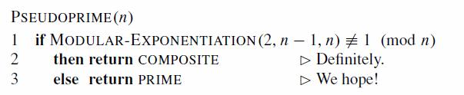
There is a procedure called pseudoprime to check primality of a number
This procedure can make errors, but only of one type. That is, if it says that n is composite, then it is always correct. If it says that n is prime, however, then it makes an error only if n is a base-2 pseudo prime.
Fermat's Theorem: Fermat’s theorem implies that if n is prime, then n satisfies equation, a ^{n−1} ≡ 1 (mod n) for every a in Z+
We say that n is a base-a pseudo prime if n is composite and a ^{n−1} ≡ 1 (mod n)
Modular Exponentiation(a,b,n) gives an efficient way to calculate

Slide 34
The Miller-Rabin primality test overcomes the problems of the simple test PSEUDOPRIME with two modifications:
1. It tries several randomly chosen base values a instead of just one base value
2. While computing each modular exponentiation, it looks for a nontrivial square root of 1modulo n, during the final set of squaring. If it finds one, it stops and returns COMPOSITE
Miller-Rabin primality test follows. The input n > 2 is the odd number to be tested for primality, and s is the number of randomly chosen base values from to be tried

Slide 35
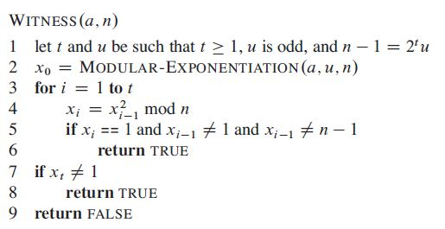
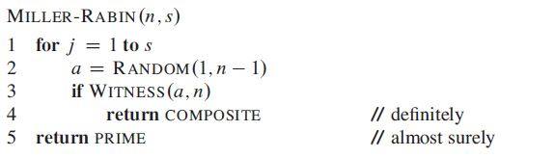
The code uses an auxiliary procedure WITNESS such that WITNESS(a, n) is TRUE if and only if ‘a’ is a “witness” to the compositeness of n—that is, if it is possible using “a” to prove (in a manner that we shall see) that n is composite.

Slide 36
Example
Consider n= 561 which we want to check whether it is prime or not.
a=2 (choose any number in rage of 1< a < n-1)
n-1=2^t * u
inorder to find t and u, we use ( n-1/2^I)
for i=1 to n-1
i=1
560/2^1=280
i=2
560/2^2=140
i=3
560/2^3=70
i=4
560/2^4=35 t=4 & u=35
i=5
560/2^5=17.5

Slide 37
x0= MODULAR-EXPONENTIATION(a, u, n);
x0= a^u mod n;
x0= 2^35 mod 561 = 263
Main loop
xi = (xi-1)^2 mod n
for I=1 to t
i=1
x1= (263)^2 mod 561
= 166
i=2
x2= (166)^2 mod 561
= 67
i=3
x3= (67)^2 mod 561
= 1
Since x3=1 so a=2 is a witness that n=561 is a composite number

Slide 38
Integer Factorization
Divide composite to primes
No well defined algorithm yet
Brute approach, improvised approach
POLLARD’S RHO
Concepts used
Congruent modulo
Greatest common divisor GCD
Floyd’s cycle detection

Slide 39
ALGORITHM
Start with random x and c. Take y equal to x and f(x)=x²+c.
While a divisor isn’t obtained
a) Update x to f(x) modulo n// Tortoise
b) Update y to f(f(y)) modulo n. // Hare
c) Calculate GCD of |x-y| and n
d) If GCD is not unity
1.1) If GCD is n, repeat from step 2 with another set of x, y and c
1.2) Else GCD is our answer

Slide 40
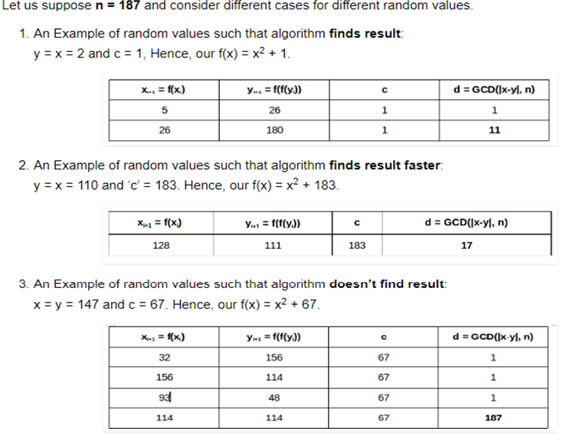
EXAMPLE

Slide 41
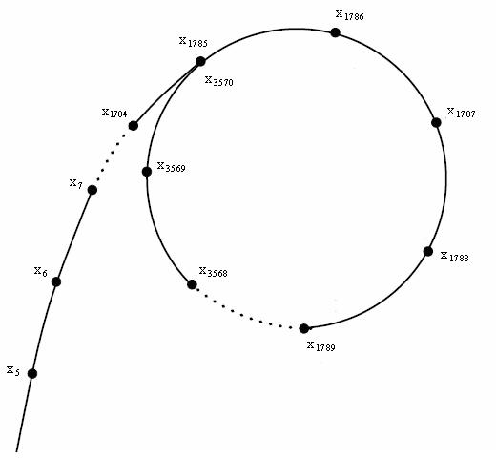
Why called Pollard’s “Rho”
While finding random numbers based on the polynomial f(x)=x² +1 we will get a series of random numbers x1,x2..... At some point a value x_{k} f(x_{k}) will be congruent to a previous f(xj). The next set of random numbers will be congruent modulo to numbers starting from xj. So a backward loop is formed , a curve in shape of “rho” is obtained.
Heuristic

Slide 42
Time Complexity
The algorithm offers a trade-off between its running time and the probability that it finds a factor. A prime divisor can be achieved with a probability around 0.5, in O(√d) <= O(n^{1/4}) iterations.
This is a heuristic claim.

Slide 43
Strassen’s Multiplication

Slide 44

Basic Matrix Multiplication
Suppose we want to multiply two matrices of size N x N: for example A x B = C.
C₁₁ = a₁₁b₁₁ + a₁₂b₂₁
C₁₂ = a₁₁b₁₂ + a₁₂b₂₂
C₂₁ = a₂₁b₁₁ + a₂₂b₂₁
C₂₂ = a₂₁b₁₂ + a₂₂b₂₂
2x2 matrix multiplication can be accomplished in 8 multiplication.(2^{log}₂⁸ =2³)

Slide 45
Basic Matrix Multiplication
void matrix_mult (){
for (i = 1; i <= N; i++) {
for (j = 1; j <= N; j++) { compute C_{i,j}; }
}}
algorithm
Time analysis

Slide 46
STRASSEN’S MATRIX MULTIPLICATION
IN LINEAR ALGEBRA STRESSEN ALGORITHM IS AN ALGORITHM FOR MATRIX MULTIPLI CATION.
ITS NAMED AFTER VOLKER STRASSEN
ITS FASTER THAN STANDARD MATRIX MULTIPLICATION AND USEFUL IN PRACTISE FOR LARGE MATRICES.

Slide 47
Strassens’s Matrix Multiplication
Strassen showed that 2x2 matrix multiplication can be accomplished in 7 multiplication and 18 additions or subtractions. .(2^{log}₂⁷ =2^{2.807})
This reduce can be done by Divide and Conquer Approach.

Slide 48
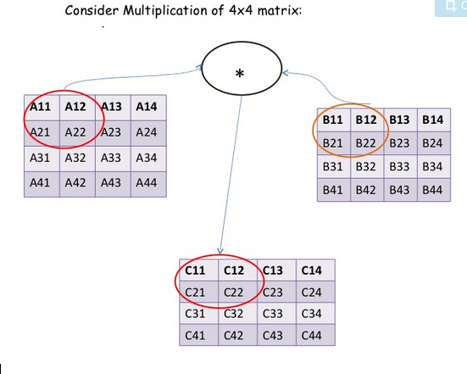
Using Divide And Conquer Approach

Slide 50
Strassens’s Matrix Multiplication
P₁ = (A₁₁+ A₂₂)(B₁₁+B₂₂) P₂ = (A₂₁ + A₂₂) * B₁₁ P₃ = A₁₁ * (B₁₂ - B₂₂) P₄ = A₂₂ * (B₂₁ - B₁₁) P₅ = (A₁₁ + A₁₂) * B₂₂ P₆ = (A₂₁ - A₁₁) * (B₁₁ + B₁₂) P₇ = (A₁₂ - A₂₂) * (B₂₁ + B₂₂)
C₁₁ = P₁ + P₄ - P₅ + P₇ C₁₂ = P₃ + P₅ C₂₁ = P₂ + P₄ C₂₂ = P₁ + P₃ - P₂ + P₆

Slide 51
Comparison
C₁₁ = P₁ + P₄ - P₅ + P₇ = (A₁₁+ A₂₂)(B₁₁+B₂₂) + A₂₂ * (B₂₁ - B₁₁) - (A₁₁ + A₁₂) * B₂₂+
(A₁₂ - A₂₂) * (B₂₁ + B₂₂)
= A₁₁ B₁₁ + A₁₁ B₂₂ + A₂₂ B₁₁ + A₂₂ B₂₂ + A₂₂ B₂₁ – A₂₂ B₁₁ -
A₁₁ B₂₂ -A₁₂ B₂₂ + A₁₂ B₂₁ + A₁₂ B₂₂ – A₂₂ B₂₁ – A₂₂ B₂₂
= A₁₁ B₁₁ + A₁₂ B₂₁

Slide 52
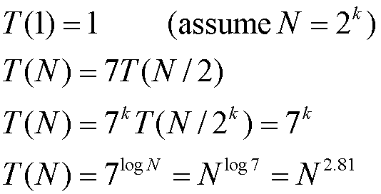
Time Analysis

Slide 53
